Slide 1
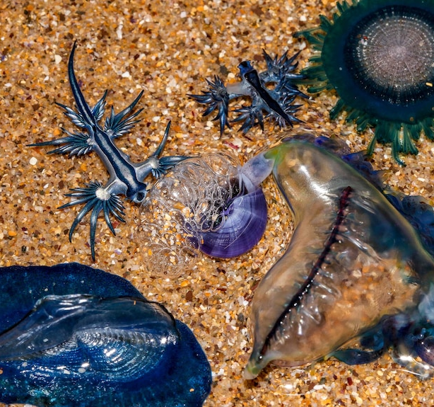
Predators, Prey and Strandings
An IBM approach to modelling the Blue Fleet
Joop Sassen

Slide 2
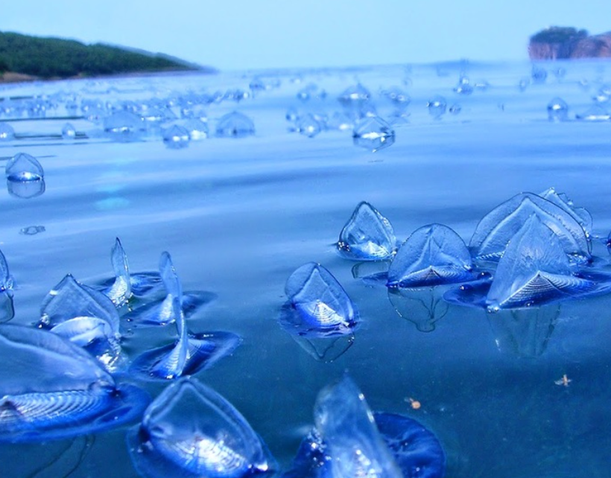
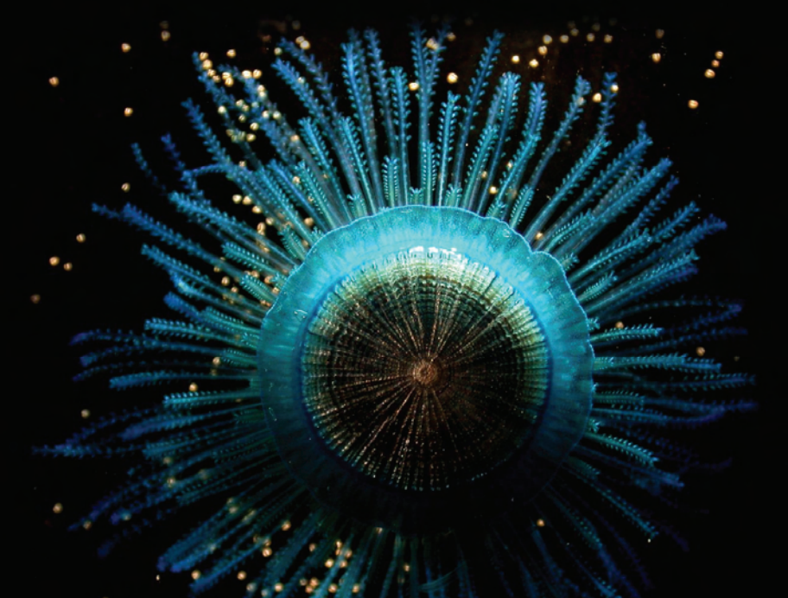
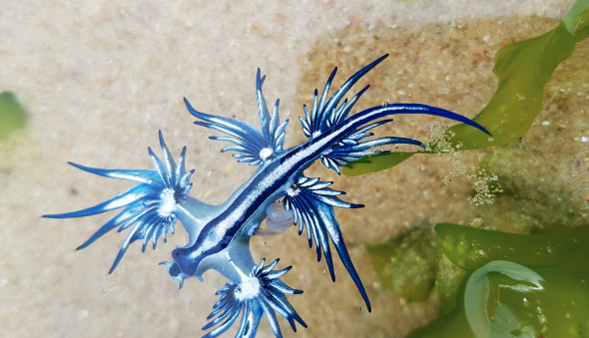
Drifting in the wind AND CURRENTS
Life at the surface – The Blue Fleet and the Neuston

Slide 3
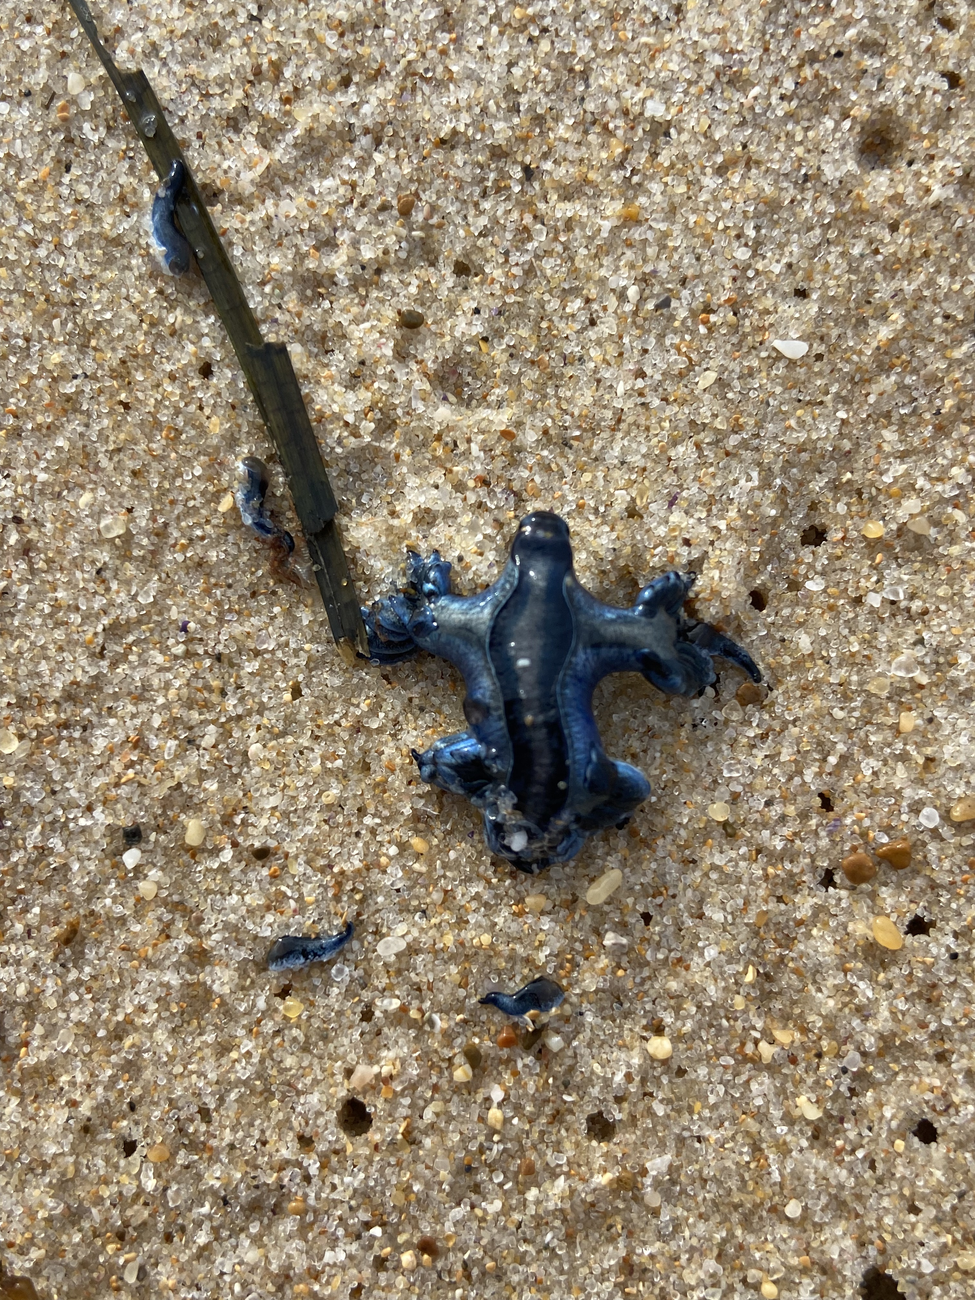
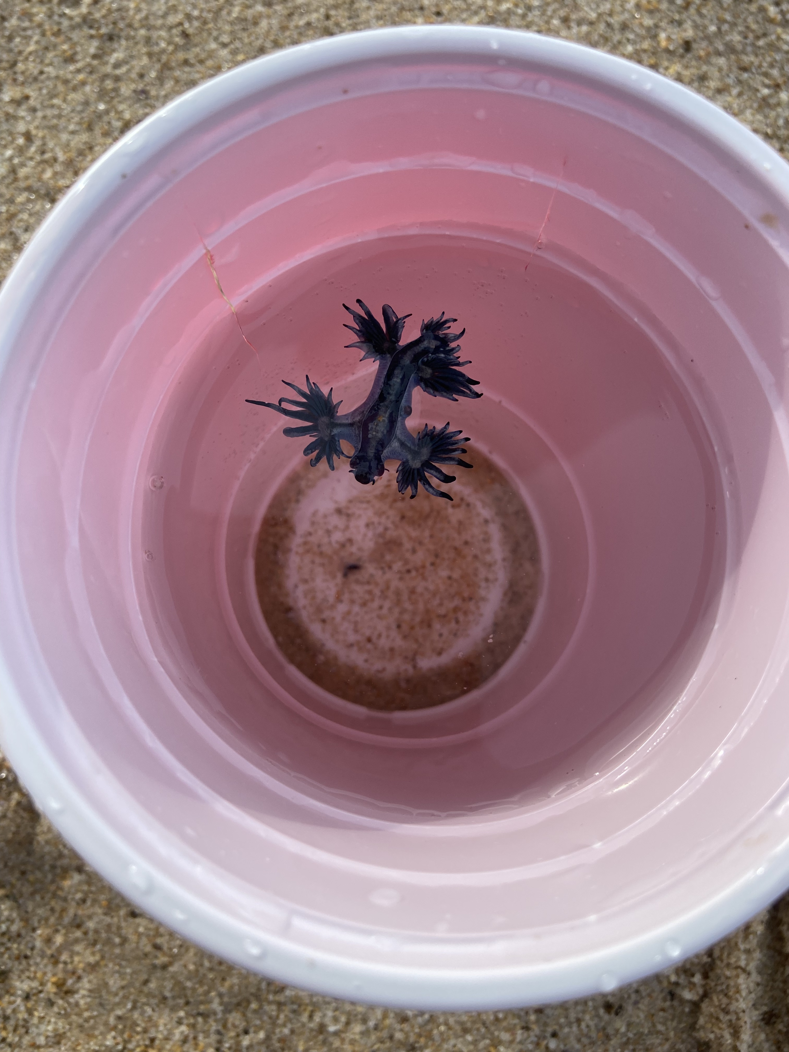
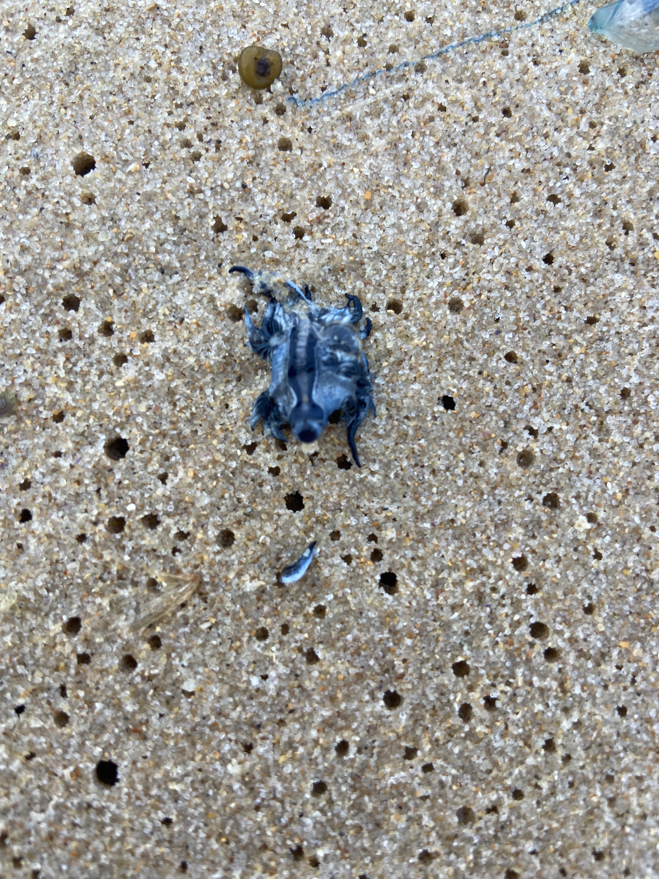
A THOUGHT-PROVOKING find
Why do some species wash up in isolation?
How does a poor swimmer find prey on the open ocean?

Slide 4
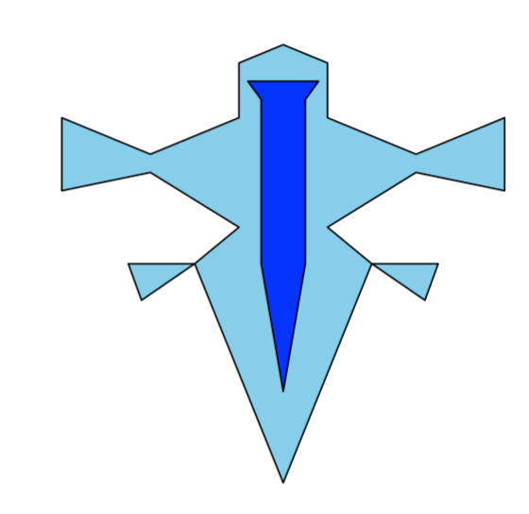
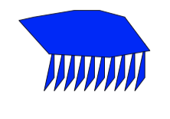
Building the model: the agents
Glaucus atlanticus
The ‘Blue Dragon’
Physalia physalis
Bluebottle

Slide 5
Physically-driven movement
Movement is a function of speed and direction of wind and currents.
Bluebottles come in two forms – impacts where wind takes them.
Different species move differently due to varying morphologies

Slide 6
BEHAVIOURAL-driven movement
Biological parameters and predatory behavior are poorly studied.
Glaucus possibly capable of some powered movement and chemodetection of prey.

Slide 7
A single model run

Slide 8

Simulating the blue fleet
v
Beaching
Current and Wind direction fixed
125,000 Simulations
Wind Speeds from 0 – 50 km/H
Current Speeds from 0 - 25 km/H
0.1 km/H increments
v
Stochastic wind and currents,
10x replicates
Current and Wind direction stochastic
125,000 Simulations * 5 replicates
Chemodetection range from 0 – 2 m
Swimming speed from 0 – 2 m/H
Prey Densities from 0 – 10x predator density
1 Simulation = 1000 hours
v
v
Current and Wind direction stochastic
125,000 Simulations * 5 replicates
Predator Behavior
LHS Design with 100 sample size,
5 replicates

Slide 9
MaiN RESULTS

Slide 10
Concluding statements
The Blue Fleet: A loose assemblage or tightly woven web?
Looser than you think! Stranding probabilities are very different …
Do Glaucus even need to move?
Probably not. When prey density exceeds xxx, there is little added value from movement or chemodetection.

Slide 11
rEFERENCES
Bourg, N., Schaeffer, A., Cetina-Heredia, P., Lawes, J. C., & Lee, D. (2022). Driving the blue fleet: Temporal variability and drivers behind bluebottle (Physalia physalis) beachings off Sydney, Australia. Plos one, 17(3), e0265593.
Grove, S. (2010). Blow-ins from the Blue Fleet. The Tasmanian Naturalist, 132, 25-34.
Helm, R. R. (2021). Natural history of neustonic animals in the Sargasso Sea: reproduction, predation, and behavior of Glaucus atlanticus, Velella velella, and Janthina spp. Marine Biodiversity, 51(6), 99.
Lee, D., Schaeffer, A., & Groeskamp, S. (2021). Drifting Dynamics of the Bluebottle. Ocean Science Discussions, 2021, 1-21.
Valdés, Á., & Campillo, O. A. (2004). Systematics of pelagic aeolid nudibranchs of the family Glaucidae (Mollusca, Gastropoda). Bulletin of Marine Science, 75(3), 381-389.

